Slide 1
Math 170 Functions, Data, and Models
26 Periodic Functions
Section 7.1-3

Slide 2
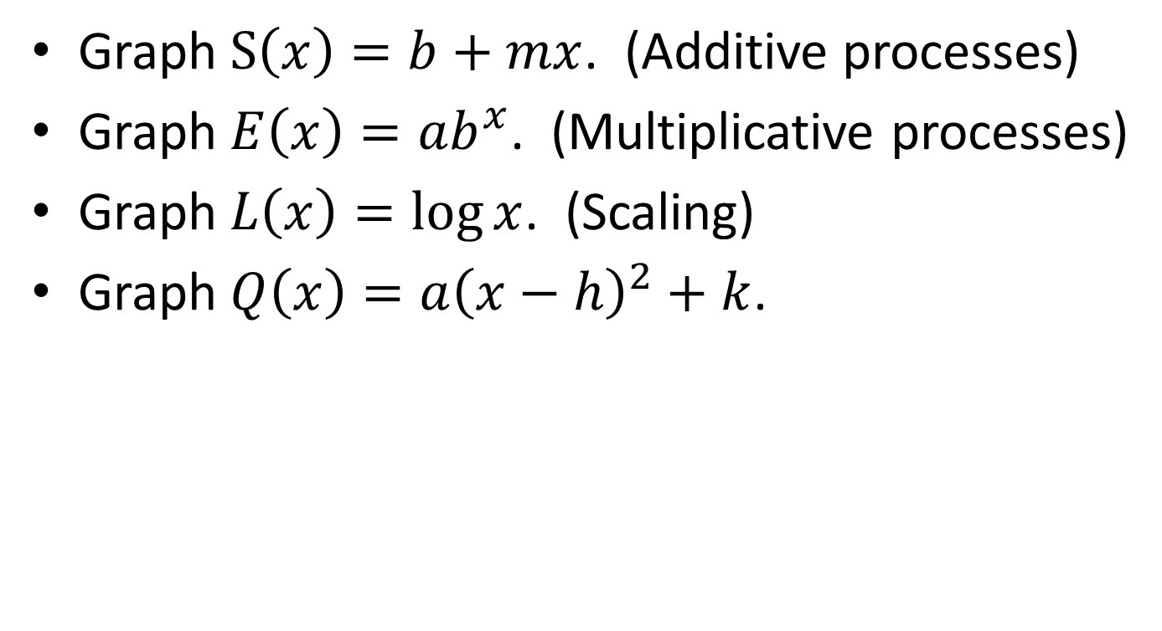
Review of Familiar Functions
Graph $S\left(x\right)=b+mx$. (Additive processes)
Graph $E\left(x\right)=ab^{x}$. (Multiplicative processes)
Graph $L\left(x\right)=\log{x}$. (Scaling)
Graph $Q\left(x\right)=a{\left(x−h\right)}^{2}+k$.

Slide 3
Ferris Wheel
A Ferris wheel of diameter 48 meters completes one revolution every 2 minutes. You start at the lowest point on the wheel, which is still 4 meters off the ground.
What are the coordinates of the center of the wheel? Mark and label that on the Ferris wheel diagram.
Construct a table of your height at 15 second intervals during one revolution of the wheel.
Draw a graph of height as a function of time from the lowest point. Include 3 revolutions of the wheel.
Determine the midline (average value), amplitude (maximum deviation from average), and period (how long until it repeats) of the function.

Slide 4
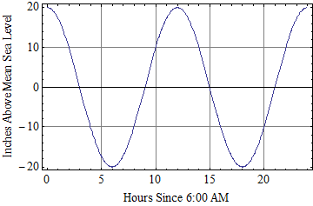
Simplified Tide
Interpret the point identified by the red arrow.
Is the tide rising or falling at 7:00 AM?
When does low tide occur?
What is the midline?
What is the amplitude?
What is the period?

Slide 5
Transformation
Let T(h) be the inches above mean sea level at h hours since 6:00 AM. (graph)
Imagine W(s) which is the height (in centimeters) above low tide at m minutes since the low tide.
Sketch W(s)

Slide 6
Cosine and Sine
See web notes…

Slide 7
Transforming Cosine and Sine
In the following, assume that the inputs to cosine and sine are in degrees.
Sketch a graph of $y=3\sin{x}+7$.
Sketch a graph of $y=\cos\left(5x\right)$.
Sketch a graph of $y=\sin\left(x−90\right)$.

Slide 8
Equations
Find an equation for this function.

